Slide 1
Information Visualization Visualization Sketch
G22-A
Number – Name
Number – Name
Number – Name

Slide 2
Overview
01

Slide 3
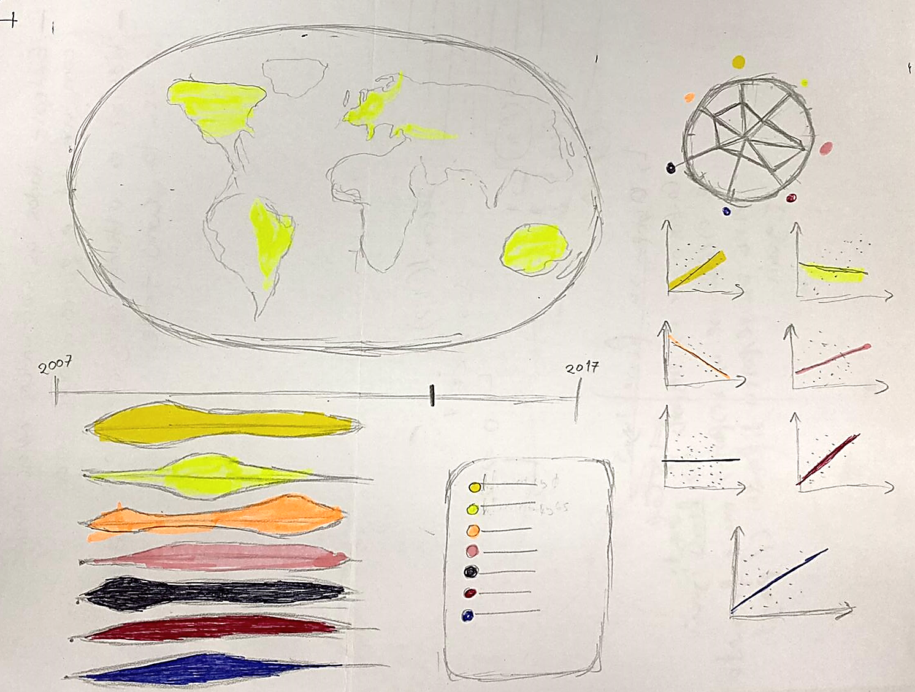
Overview
Overview of your screen (including the several idioms you are going to use, highlighting how the work together, etc.)
(This should be a visual sketch, not just “talk”!)

Slide 4
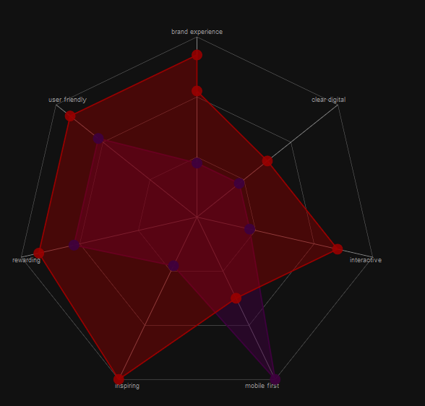
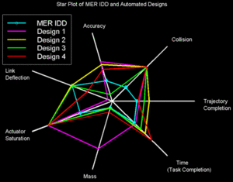
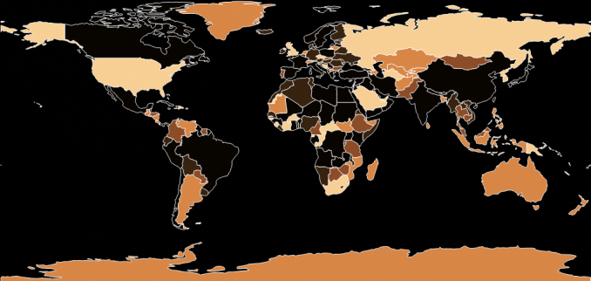
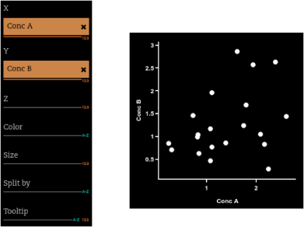


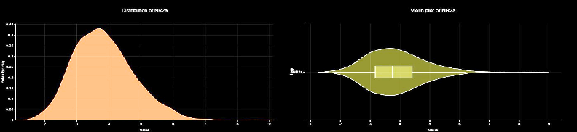
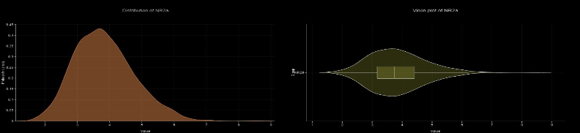

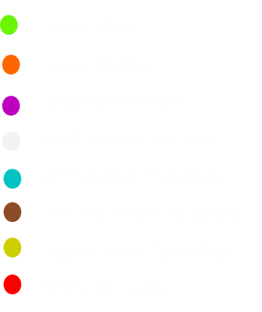





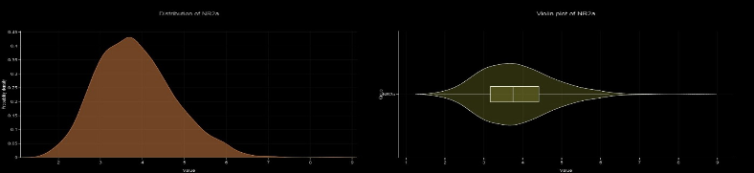

Overview
Better Wage
Hours Worked
Employment Rate
Adult education Level
Air Pollution Exposure
Self Reported Happiness
Bigger Social Spending
GDP per Capita
2007
2012
2017

Slide 5
Visual encoding
02

Slide 6
Visual Encoding
Choropleth map health influencers | Relating country with health influencer:
Visual Encoding:
Map -> Colour: filling each country with the colour of the
Selected variable.
Channel -> colour -> hue: a higher value for the hue represents a higher value of the selected variable.

Slide 7
Visual Encoding
Scatter plot as small multiples| Relation between health factors and influencers:
Visual Encoding:
Marks -> Point: represents a pair (health variable, health influencer)
Marks -> Line: represents the linear approximation of the scatterplot between the 2 variables.

Slide 8
Visual Encoding
Scatter plot as small multiples| Relation between health factors and influencers:
Visual Encoding: (Cont.)
Channel -> position: represents the position of the point in a Cartesian axis.
Pictograph -> Represents the respective health variable being correlated with health influencer

Slide 9
Visual Encoding
Star plot| Correlation coefficient between health influencers and factors:
Visual Encoding:
Marks -> Point: represents the correlation coefficient normalized between 0 and 1.
Channel -> colour -> hue: The colour of the area between the points in the start chart represents the variable being analysed.

Slide 10
Visual Encoding
Violin plot as small multiples| Type:
Visual Encoding:
Pictograph -> Represents the respective health variable
Curve -> Represents the distribution of each of the health variables and the selected health influencer
Size -> Is proportional to cardinality countries of the value interval

Slide 11
Visual Encoding
Health influencer slider| influencer selected for visualization:
Visual Encoding:
Channel -> position: represents the health influencer being displayed
Channel -> colour: represents the health influencer being displayed

Slide 12
Visual Encoding
Health influencer legend | influencer selected for visualization:
Visual Encoding:
Channel -> colour: represents the relation between the coulor with each influencer (word on its right)

Slide 13
Visual Encoding
Years slider| year selected for visualization:
Visual Encoding:
Channel -> position: represents the year being displayed

Slide 14
Answering the Questions
03

Slide 15
Question <n>
<Question>
(Visual) explanation of how the vis allows us to answer it
For at least one of the questions: storyboard depicting the use of several idioms in tandem.

